Slide 1

principles of industrial engineering
MED 210

Slide 2

MED 210 Mini project part ii
Product: Bluetooth trolley speaker
Done by:
Leela Krishna Pendyala
Praneeth Krishna Palle
Srikara Sriapathi

Slide 3

Description
After Preparing the BOM file and Calculating Assembly time in the first half of the project, in the second half of this project, we were asked to do the following things:
Prepare a Work Description sheet, which consist of a table listing out the works carried out on the product while Assembling, the time taken(in minutes) for Assembling each and every Part/Assembly/Sub-Assembly and a Pre-Activity table, Indicating the activity which is to be completed before we move on to our current activity.
Preparing Precedence Diagram.
Cycle time calculation.
Preparing a Workstation Layout.
Preparing Working Time Indicator Graph.

Slide 4
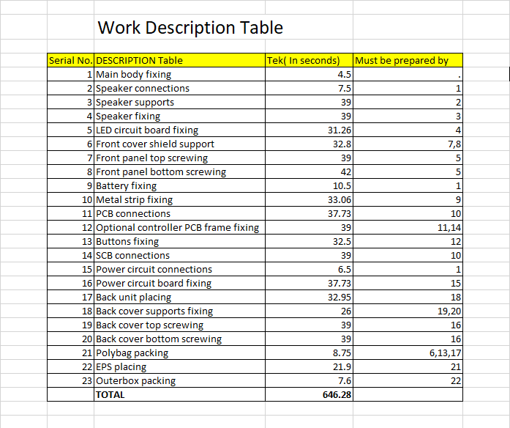
Work Description Table

Slide 5
Precedence Diagram
37.73sec
11
10.5 sec
33.06sec
39sec
9
10
12
39 sec
32.5sec
14
7
13
7.5 sec
39 sec
39 sec
31.26 sec
8.75sec
21.9 sec
7.6 sec
1
2
3
4
5
39 sec
6
21
22
23
4.5 sec
8
32.8 sec
17
19
42 sec
37.73 sec
32.95 sec
15
16
39 sec
18
6.5 sec
20
26 sec
39 sec

Slide 6


Work Station Layout
Work Station 1
Work Station 2
Work Station 3
Work Station 4
Work Station 5
1. Main body fixing.
2. Speaker connections
3. Speaker support
4. Speaker fixing.
11. PCB connections
14. SCB connections
9. Battery fixing
10. Metal strip fixing
12. Optional controller PCB frame fixing.
13. Buttons fixing.
6. Front cover shield support.
7. Front panel top screwing.
8. Front panel bottom screwing.
5. LED circuit board fixing.
15. Power circuit connections.
16. Power circuit board fixing.
17. Back unit placing.
18. Back cover support fixing.
19. Back cover top screwing.
20. Back cover bottom screwing.
21. Polybag packing.
22. EPS placing.
23. Outer box packing.

Slide 7
Parameters considered for calculation of cycle time
Here are a few Parameters and formulas we have taken while calculating Cycle time:
Annual Demand of 1 million.
6 working Days per Week.
48 Working weeks in a year.
Demand of That Day=(Annual Demand)/(48*H)
Available Working Time in a Day = 3600*(No. of Production Lines)*(Number of Shifts)*(Working hours in a shift)

Slide 8
Cycle time calculation
Number of Production lines:2
Number of shifts: 3
Number of Working hours in a shift:8 hours
Efficiency(η) of 85%
Cycle Time(Tc)=(Available Working Time in a Day)/[(Demand of that day)*(η)]

Slide 9
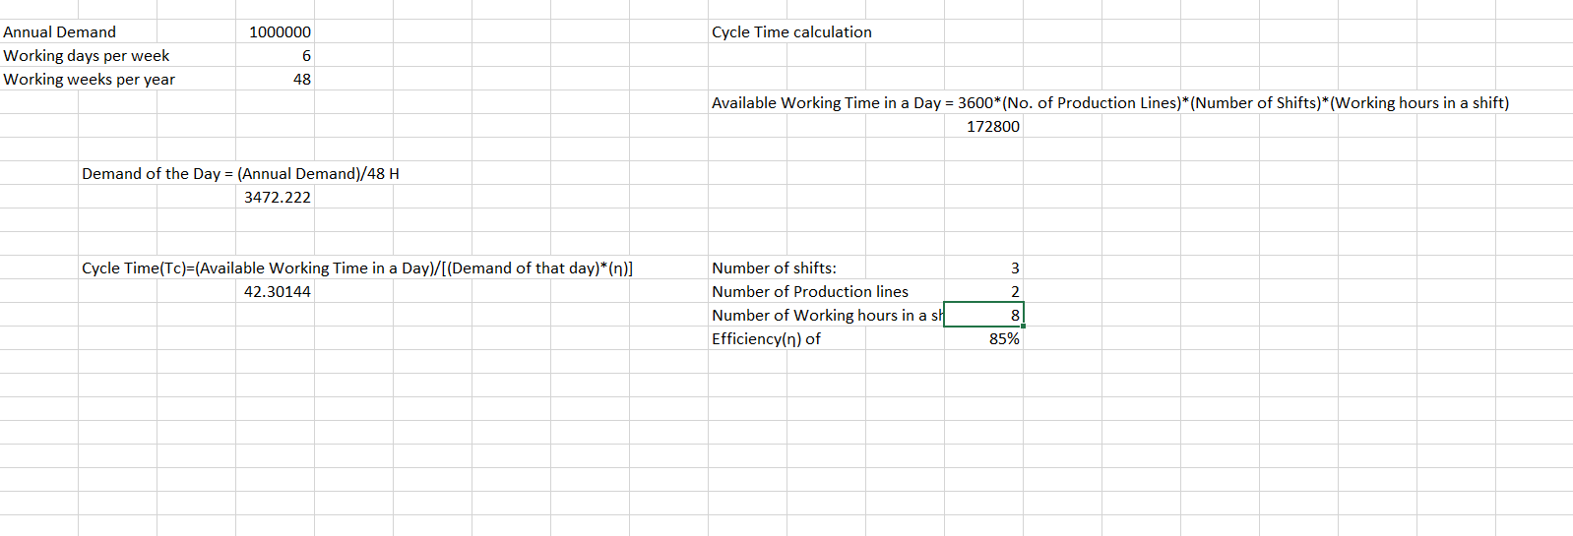
Cycle time calculation

Slide 10
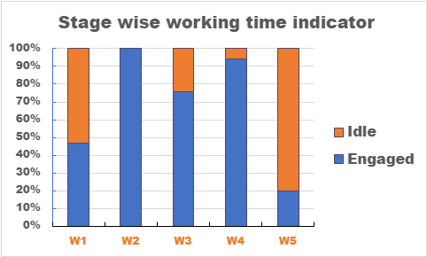

Slide 11

THE END
THANK YOU!!

